Slide 1
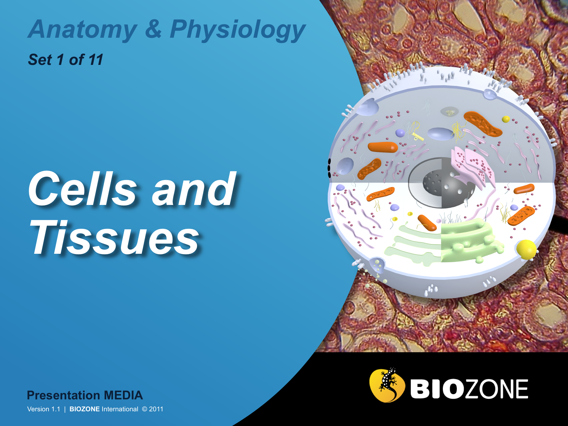

Slide 2
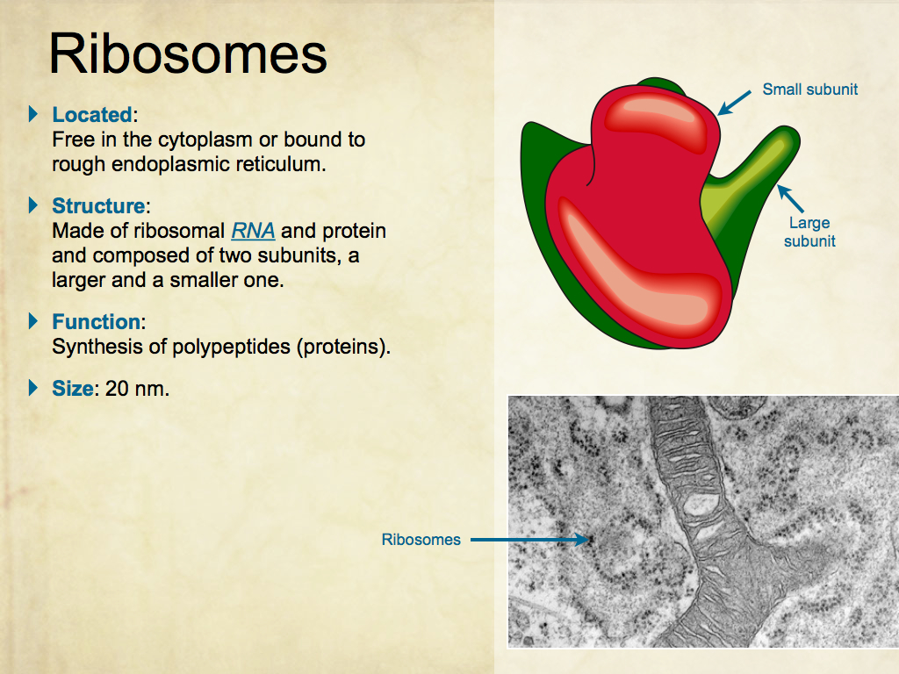
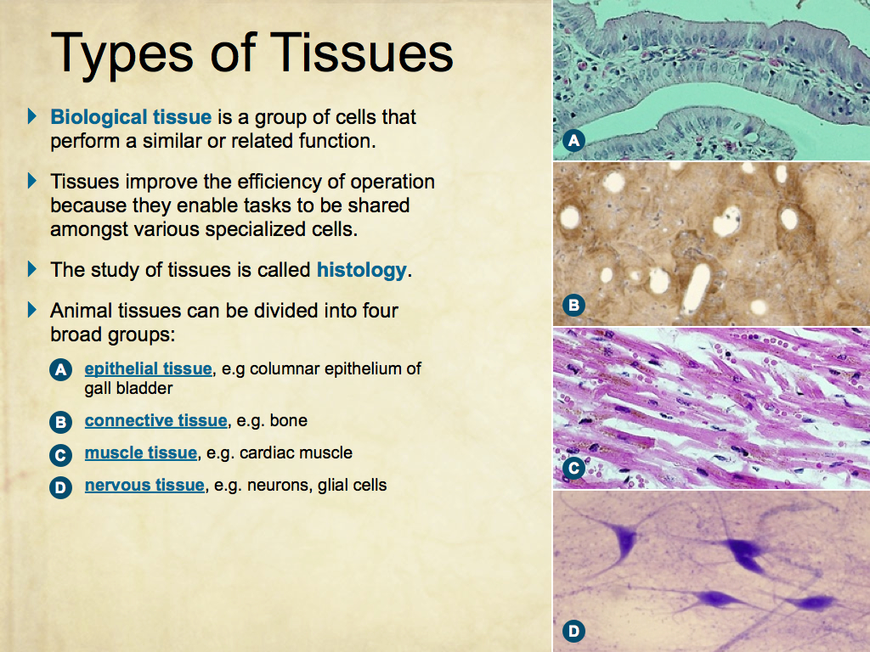
Using Presentation Media
BIOZONE Presentation Media
can be used either as a simple slide show or as an interactive lesson.
  Hyperlinks within the text take you to related slides.
Italicized hyperlinks link to the glossary of definitions.
Bold hyperlinks give direct access to specific slides.

Slide 3
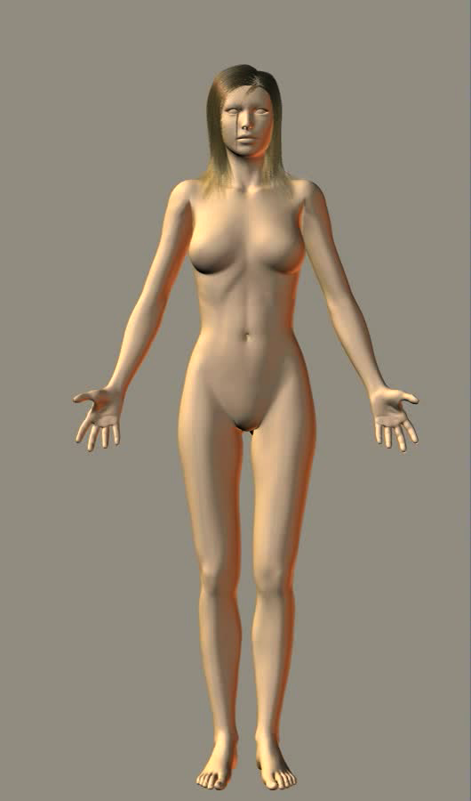
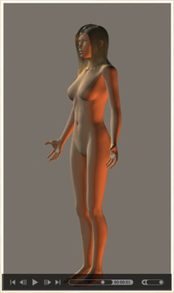
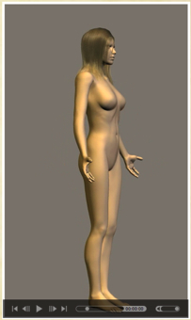
Using Presentation Media
BIOZONE Presentation Media can be used either as a simple slide show or as an interactive lesson
  The movie player allows you to rotate objects.
The movie loops continuously when activated
Use the movie controls in Keynote or Powerpoint
Pause the movie, then drag the slider to rotate the object back and forth

Slide 4
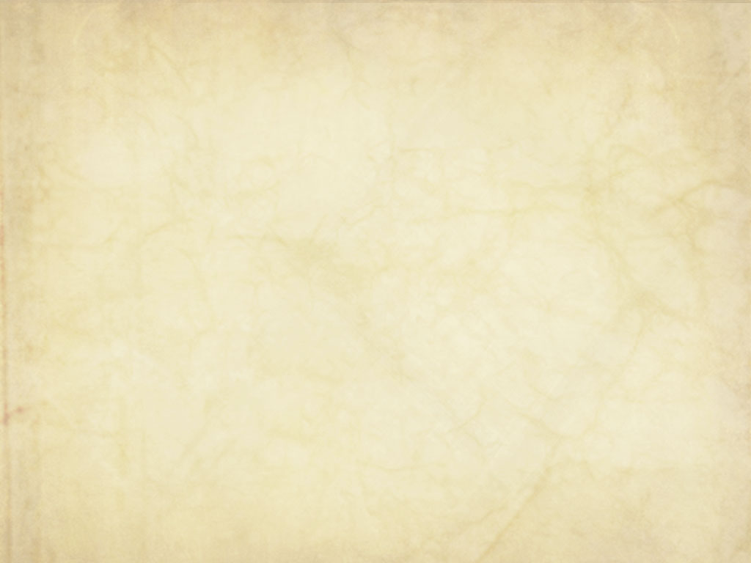
Contents
1) Using Presentation Media
2) Cells and Organelles
  Cell characteristics
  Basic cell structure
  Organelles
  Cell processes
3) Membranes and Transport
  Membrane structure
  Role of the membrane
  Cell transport
  Endocytosis
  Exocytosis
4) Cell Division
  Cell division
  Mitosis and the cell cycle
  Meiosis
5) Cells and Tissues
  Differentiation of cells
  Cell specialization
  Types of tissue
  Levels of organization
  Human organ systems
6) Glossary
Click on the hyperlink title you wish to view

Slide 5
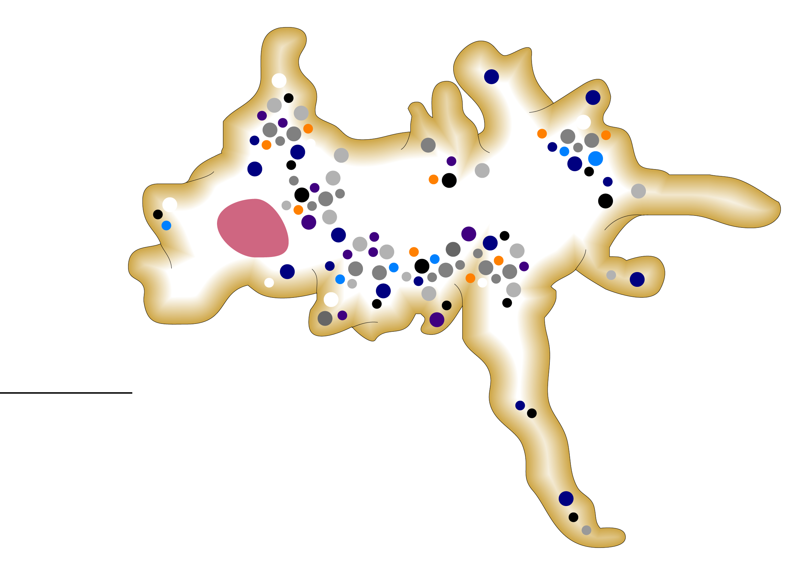
Cell Characteristics
Cells remain alive as long as the metabolic reactions in the cytoplasm are maintained.
With a few rare exceptions (which involve freezing certain types of cells) the cell dies if metabolism is stopped for any reason.
Plasma membrane
In eukaryotes, the DNA (as chromosomes) is contained within a nuclear membrane
100000 nm
scale
Specialized organelles carry out specific functions in the cell.
Metabolism takes place in the cytoplasm.
Amoeba:
a single celled eukaryote

Slide 6
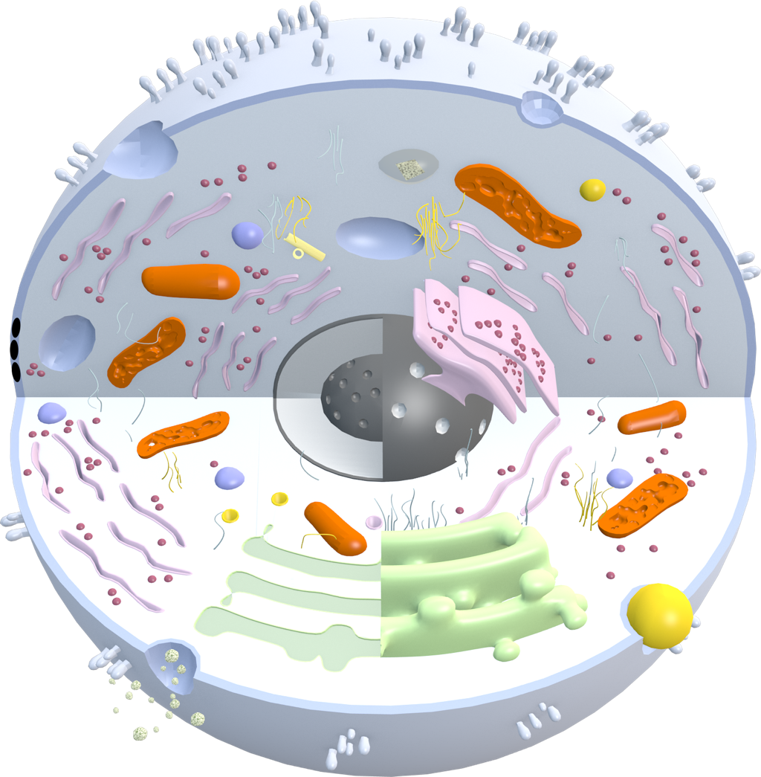
Basic Cell Structure
Peroxisome
Microvilli
Lysosome
Centrioles
Plasma membrane
Cytoplasm
Tight junction
Ribosome
Mitochondria
Rough endoplasmic reticulum
Endoplasmic reticulum
Golgi apparatus
Nucleolus
Nucleus
Nuclear pore

Slide 7
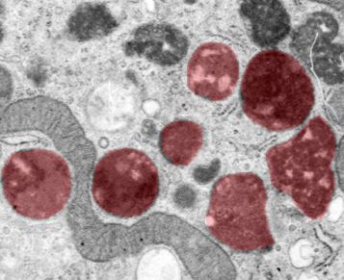
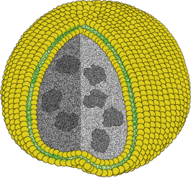

Lysosome
Located:
Throughout the cell; pinched off the Golgi.
Structure:
Lipid membrane-bound sac, which may contain degraded material.
Function:
  Breaks down foreign material using:
    Amylase, lipases, nucleases,
    phosphoric acid,
Size: 0.5-1.5 µm diameter
Lipid layer
Fragments of degraded material

Slide 8
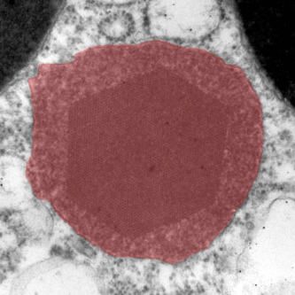
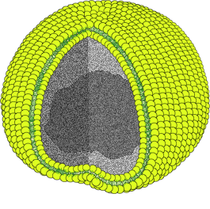
Peroxisomes
Located:
Throughout the cytoplasm.
Structure:
Crystalline core containing oxidative enzymes, surrounded by a lipid membrane.
Function:
  Rids the body of toxic substances.
  Important in the liver and kidneys which are the main sites of detoxification.
Size: 0.5-1.5 µm diameter.
Photo: Alexandre Lobo da Cunha, University of Porto
Magnified view of interior of peroxisome
Lipid membrane
Crystalline core

Slide 9

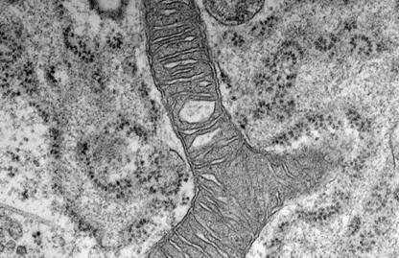
Ribosomes
Small subunit
Located:
Free in the cytoplasm or bound to rough endoplasmic reticulum.
Structure:
Made of ribosomal RNA and protein and composed of two subunits, a larger and a smaller one.
Function:
Synthesis of polypeptides (proteins).
Size: 20 nm.
Large subunit
Ribosomes

Slide 10
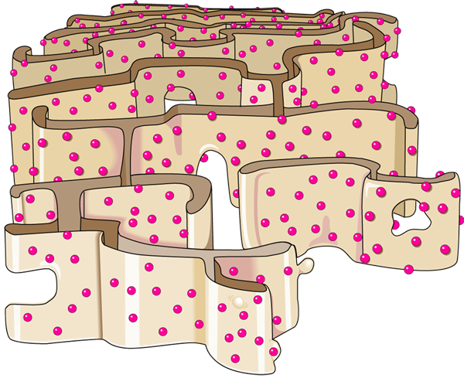
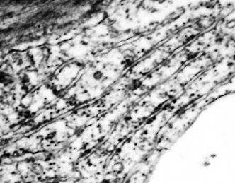
Rough Endoplasmic Reticulum
Membranous tubules
Located:
Continuous with the nuclear membrane and extending to the cytoplasm as part of the endomembrane system.
Structure:
A complex system of membranous tubules studded with ribosomes. Connected to the smooth ER but structurally and functionally distinct from it.
Function:
  Synthesis, folding, and
  modification of proteins.
  Transport of proteins through the cell.
  Membrane production.
Size: Variable according to cell size.
Ribosome
Transport vesicle budding off

Slide 11
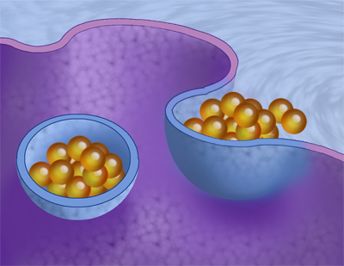
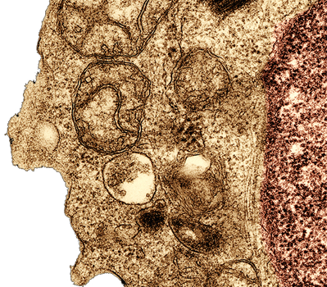
Vacuoles and Vesicles
Located:
In the cytoplasm - often numerous.
Structure:
Vacuoles and vesicles are both membrane-bound sacs, but vacuoles are larger.
Function:
  Food vacuoles in animal cells are formed by phagocytosis of food particles.
Size: Varies according to the size and type of cell.
Food vacuole in a human lymphocyte

Slide 12
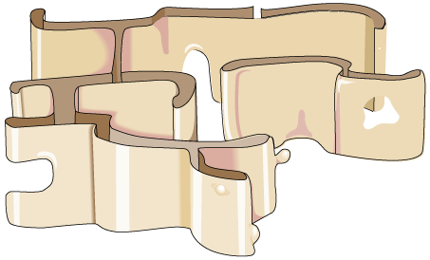
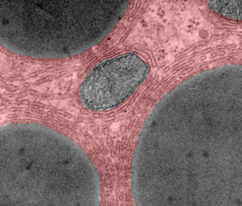
Smooth Endoplasmic Reticulum
Membranous tubules lacking ribosomes
Located:
In the cytoplasm as part of the endomembrane system.
Structure:
A system of membranous tubules
similar to rough ER but lacking ribosomes (hence smooth).
Function:
  Synthesis of lipids, including oils, phospholipids, and steroids.
  Carbohydrate metabolism.
  Transport of these materials through the cell.
  Detoxification of drugs and poisons.
Size: Variable according to cell size.
Transport vesicle budding off

Slide 13
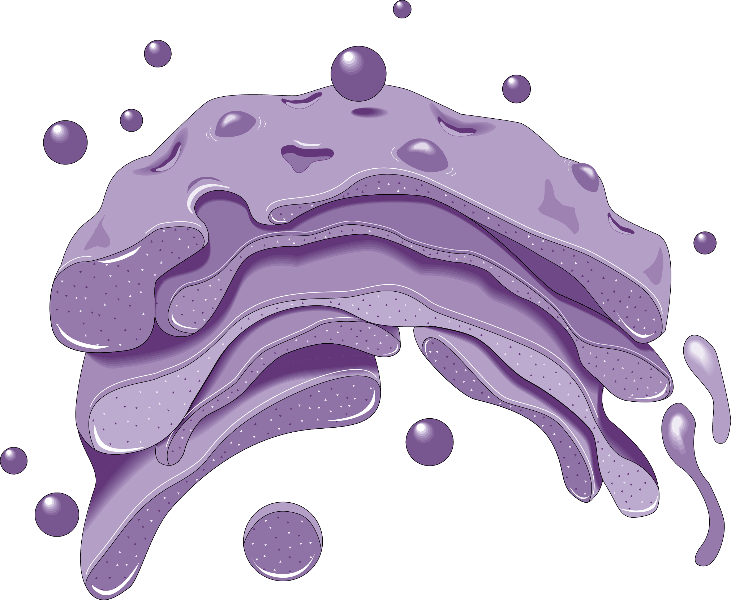
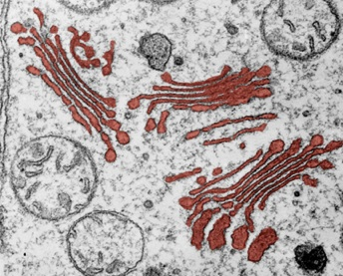
Golgi Apparatus
Transfer vesicle from the ER
Located:
Cytoplasm, associated with the ER.
Structure:
Stack of flattened, membranous
sacs called cisternae.
Function:
  Modification of proteins and lipids received from the ER.
  Sorting, packaging, and storage
  of proteins and lipids.
  Transport of these materials in vesicles through the cell.
  Manufacture of some certain macromolecules, e.g. hyaluronic acid.
Size: 1-3 µm diameter.
Also called: Golgi, Golgi body.
Cisternae
Vesicle from the ‘shipping’ side of the Golgi

Slide 14
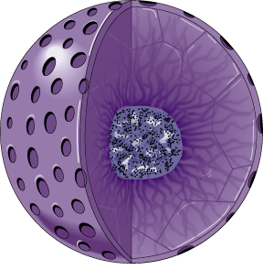
Nucleus
Located:
Variable location; not necessarily near the center of the cell.
Structure:
Contains the chromatin (genetic material) within a nuclear membrane.
  Nuclear membrane (or envelope) is a double membrane perforated by pores ~100 nm in diameter.
  The two membranes are separated
  by a space of ~20-40 nm.
Function:
Contains most of the cell’s genetic material, responsible for regulating
all the activities of the cell.
Size: 5 µm diameter.
Nuclear pore
Nuclear membrane
Nucleolus
Chromatin

Slide 15
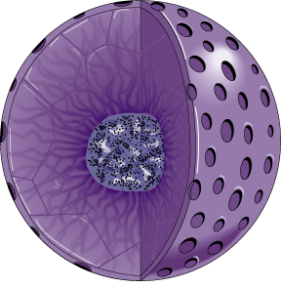
Nucleolus
Located:
Within the nucleus.
There may be more than one, depending on the organism.
Structure:
A prominent structure which appears under EM as a mass of darkly stained granules and fibers adjoining part of the chromatin.
Function:
  Synthesis of ribosomal RNA.
  Assembly of ribosomal subunits.
Size: 1-2 µm diameter.
Nucleolus

Slide 16
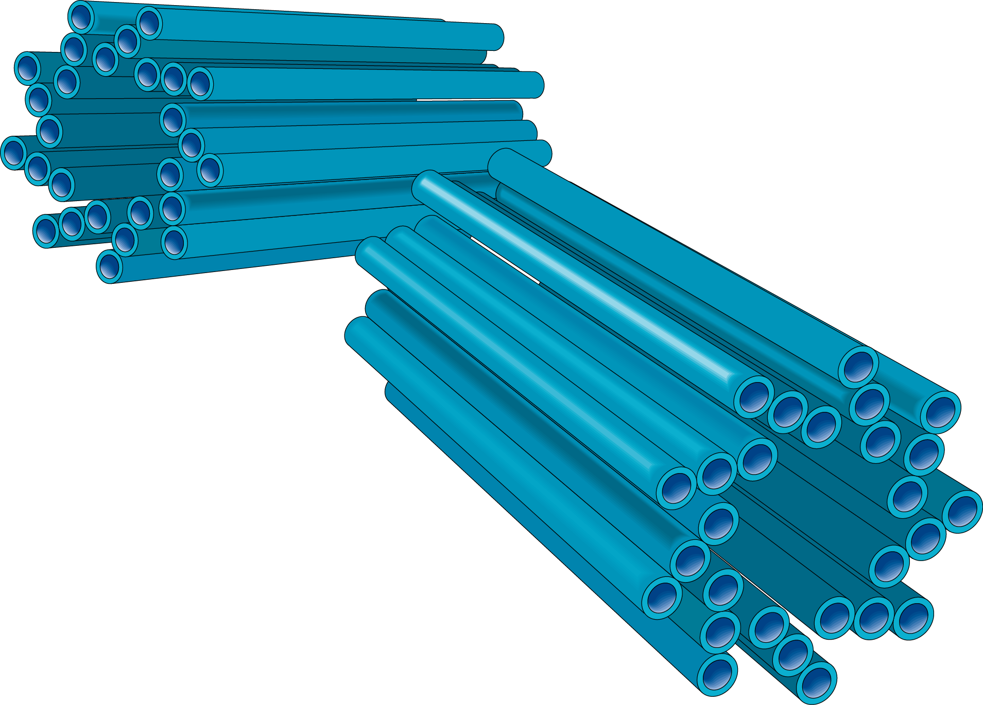
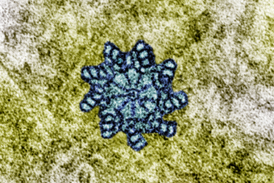
Centrioles
Located:
In the cytoplasm of most animal cells, as part of the cytoskeleton. Usually next to or close to the nucleus.
Structure:
Associated as a pair, at 90° to each other. Eeach one composed of nine sets of triplet microtubules arranged in a ring.
Function:
Involved in organizing microtubule assembly (spindle formation) although they are absent from the cells of higher plants and fungi.
Size: 0.25 µm diameter.
Microtubules
Centriole in cross section

Slide 17
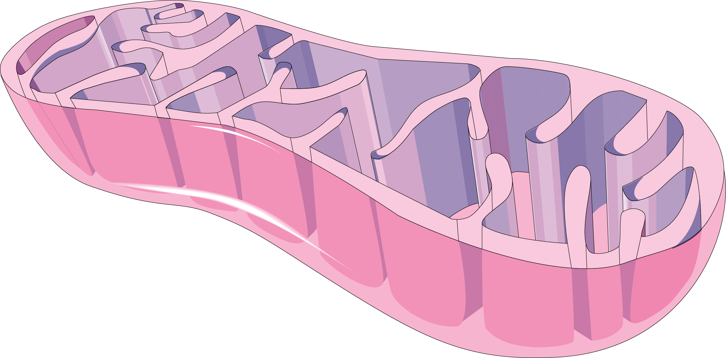
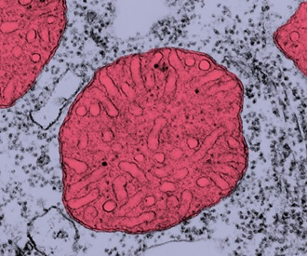
Mitochondria
Matrix
Folded inner membrane forms cristae
Located:
Cytoplasm
Structure:
Cylindrical organelles occurring in large numbers, especially in metabolically very active cells. Bounded by a double membrane; the inner layer is extensively folded to form partitions called cristae. Mitochondria contain some DNA.
Function:
The site of cellular respiration (the production of ATP).
Size: Variable but 0.5–1.5 µm wide and 3.0–10 µm long.
Smooth outer membrane
A single mitochondrion in cross section

Slide 18
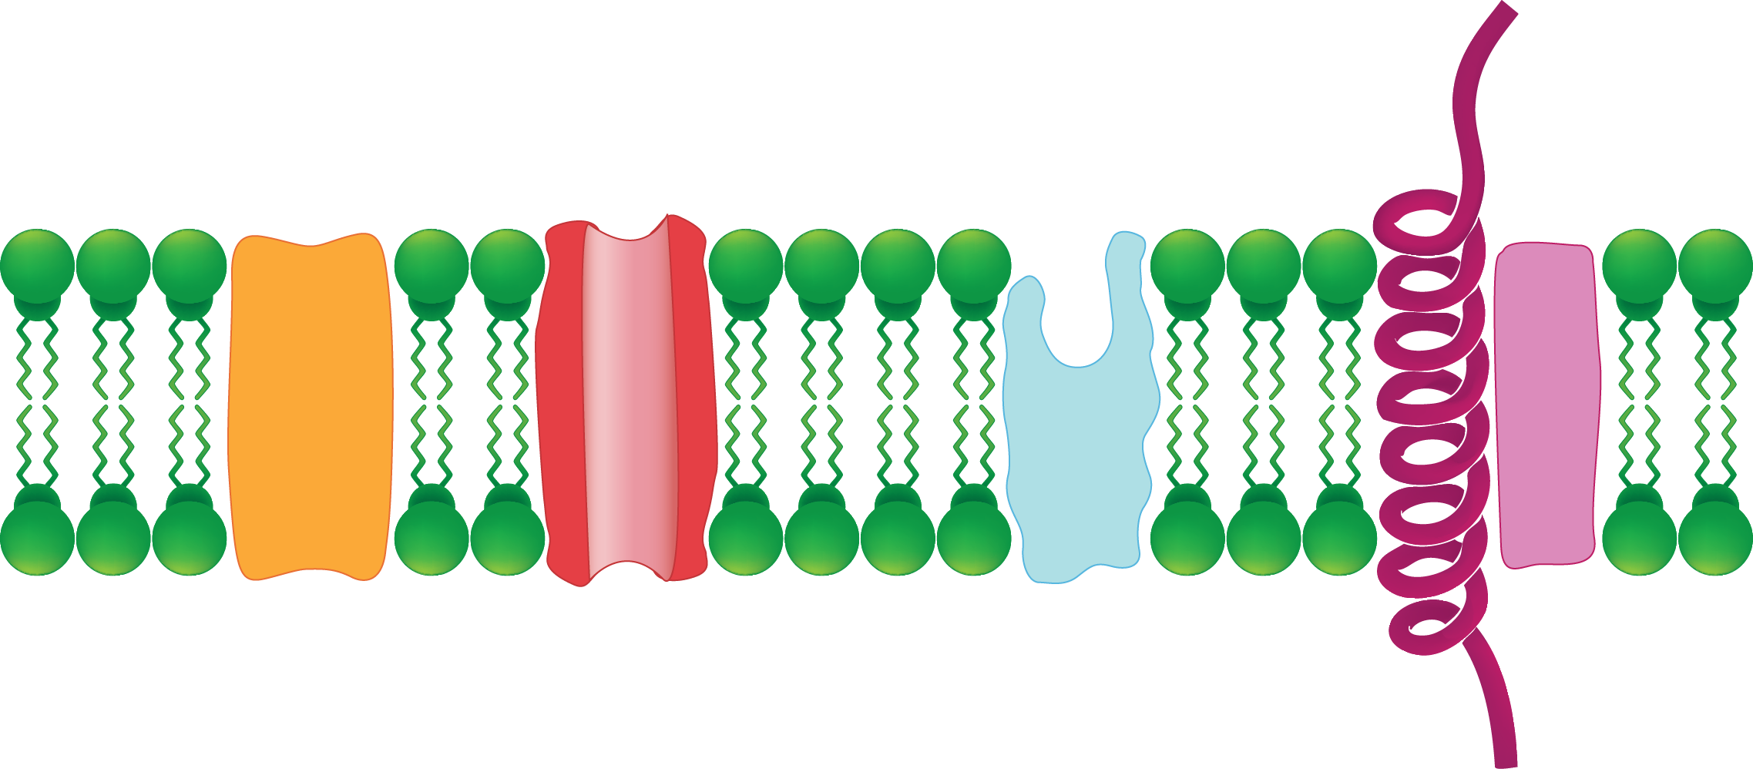
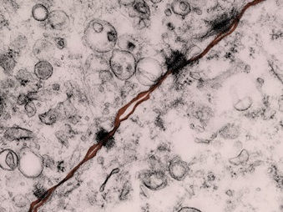
Plasma Membrane
Located:
Surrounds the cell forming a
boundary between the cell contents
and the extracellular environment.
Structure:
Semi-fluid phospholipid bilayer in which proteins are embedded. Some of the proteins fully span
the membrane.
Function:
  Forms the boundary between the cell and the extracellular environment.
  Regulates movement of substances in and out of the cell.
Size: 3–10 nm thick.
Phospholipid bilayer
Protein
The plasma membranes of two adjacent cells joined with desmosomes

Slide 19
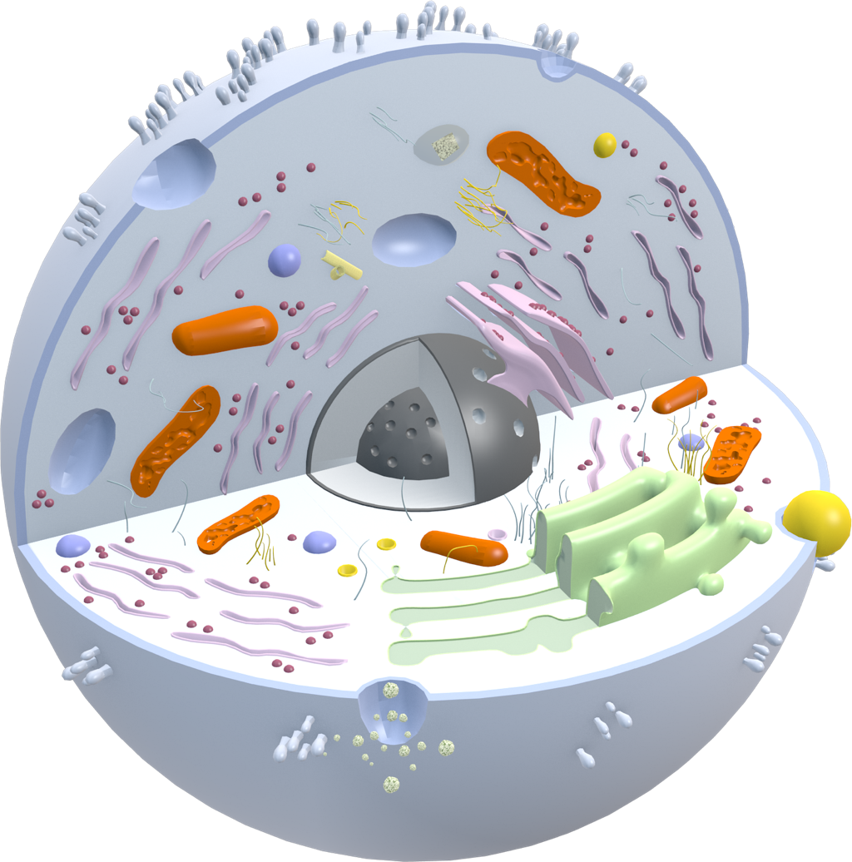
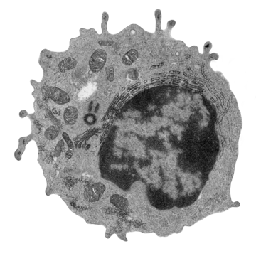
Cytoplasm
Located:
Throughout the cell, excluding organelles.
Structure:
Watery solution containing dissolved substances, enzymes, and the cell organelles and structures.
Function:
  The cytoplasm includes the cytosol, the gel-like fluid containing dissolved substances.
  The cytoplasm has functions in maintaining cell structure and shape.
  Some vital metabolic reactions occur here, such as the breakdown of glucose into pyruvate.
Size: Depends on cell type and size.
Cytoplasm
TEM image of whole animal cell

Slide 20
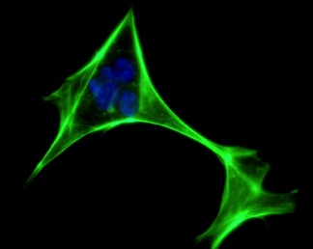
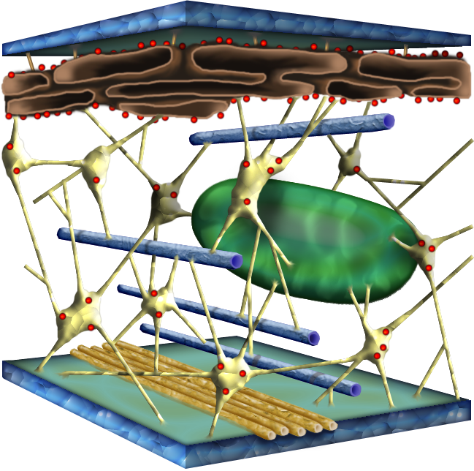
The Cell Cytoskeleton
Located:
A network throughout the cytoplasm.
Structure:
A dynamic system of microtubules, microfilaments, and intermediate filaments.
Function:
  Shape and mechanical support for the cell.
  Regulation of cellular activities, e.g. guiding secretory vesicles.
  Especially important in animal cells.
  Involved in cell movement (motility).
Size:
  Microtubules: 25 nm
  Microfilaments (actin filaments): 7 nm
  Intermediate filaments: 8-12 nm
An actin stain reveals the cytoskeleton of a fibroblast
iStock

Slide 21
The Cell Cytoskeleton
Plasma membrane
Intermediate filament
An organelle held in place by the cytoskeleton
Microtubule
Microfilament

Slide 22
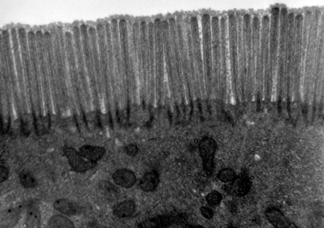
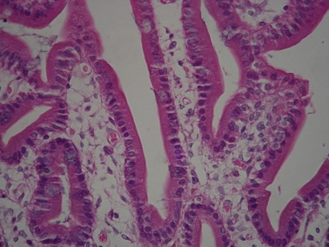
Microvilli
Located:
Along the borders of some epithelial cells. Cells containing microvilli are
located in:
  The small intestinal tract for absorption of nutrients from food.
  The proximal tubule of the kidney for reabsorption.
Structure:
Finger-like extensions of the plasma membrane, called microvilli.
Function:
Increases the surface area of the cell for greater absorption of material.
Size: 1-2 µm long.
Microvilli
Dartmouth College
Image:WbenSmith
Brush border

Slide 23
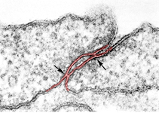
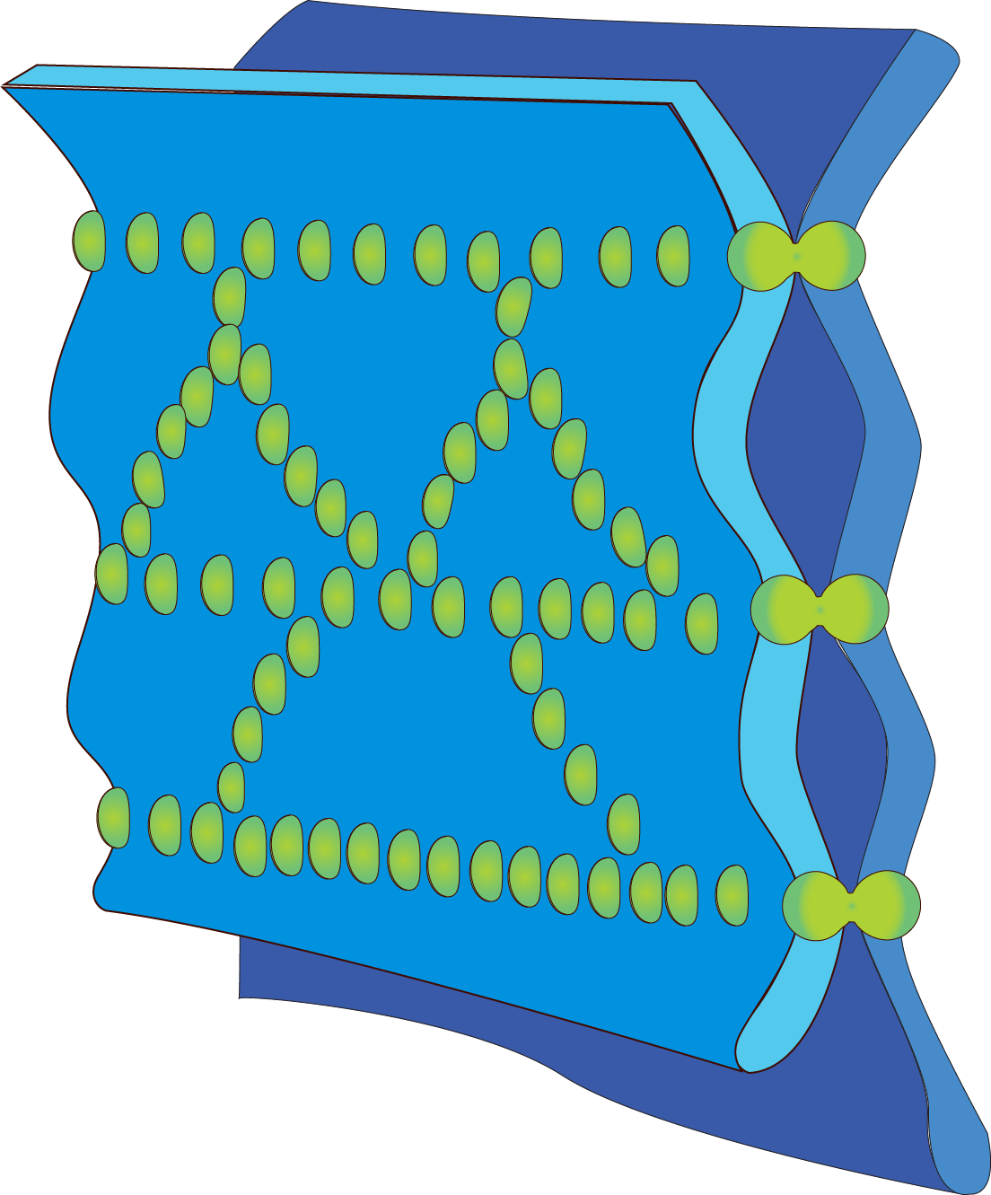
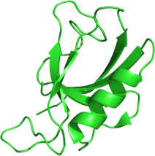
Tight Junctions
Located:
Within the plasma membrane. Common in cells of the stomach, intestines, and bladder.
Structure:
Transmembrane proteins form a branching network of sealing strands connecting with the cytoskeleton.
Function:
  Junctions that bind neighboring cells together.
  Junctions are impermeable to water, and prevent fluid passing between cells or leaking from cavities.
Size: 0.5-2 nm diameter.
University of Delaware
Tight junction protein
Proteins forming tight junctions
Plasma membrane

Slide 24
Cell Processes
Cell division
Digestion and detoxification
Protein synthesis
Cellular respiration
Cellular transport
Maintaining cell structure

Slide 25
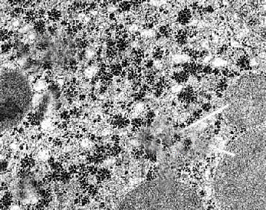
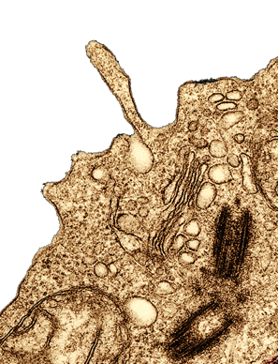
Digestion and Detoxification
1
Digestion
  Lysosomes contain powerful digestive enzymes that digest and destroy unwanted cell organelles and foreign material entering the cell.
Detoxification
  Peroxisomes contain enzymes that use molecular oxygen to oxidize various potentially toxic organic substances.
2
2
Interior of lysosome
1
Lysosomes in a lymphocyte. Note how they are budding from the Golgi

Slide 26
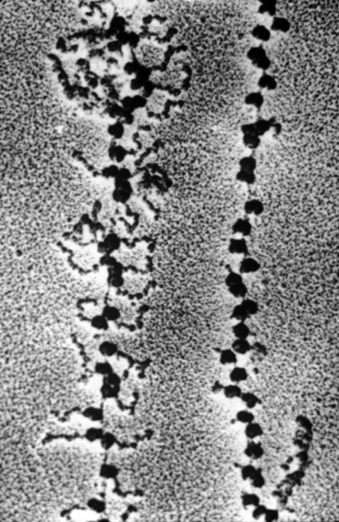
Protein Synthesis
3
Protein synthesis
  Protein synthesis occurs in two stages, transcription in the nucleus and translation in the cytoplasm.
  Chromosomes in the nucleus store the genetic instructions for the production of specific proteins.
  These proteins are constructed by ribosomes both on the endoplasmic reticulum and free in the cytoplasm.
Polypeptide chain
3
Ribosomes

Slide 27
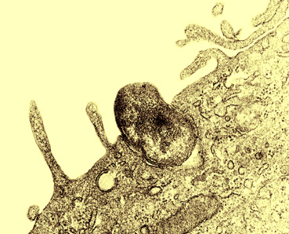
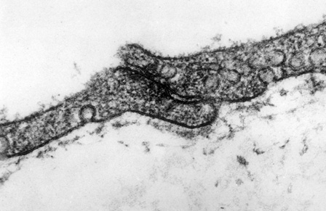
Cellular Transport
4
Endocytosis
  The plasma membrane can engulf objects (such as bacteria).
  The membrane pinches off to become a vesicle, and the enclosed material is digested by powerful enzymes.
5
Exocytosis
  Substances transported in membrane-bound vesicles merge with the plasma membrane and exit from the cell.
Endocytosis of solid particle (phagocytosis)
4
TEM X162,000
5
Exocytosis of from cardiac muscle cells.

Slide 28
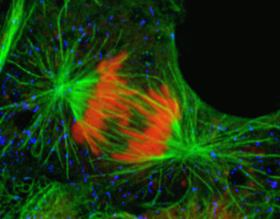
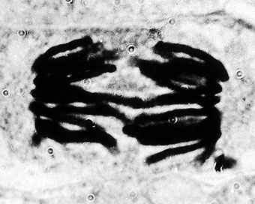
Cell Division
6
Cell division
Cell division is the process during which forms new cells.
The nuclear material replicates during mitosis.
In animal cells, centrioles control the movement of chromosomes during cell division.
False color image of spindle fibers
during mitosis
6
Mitosis (early anaphase)

Slide 29
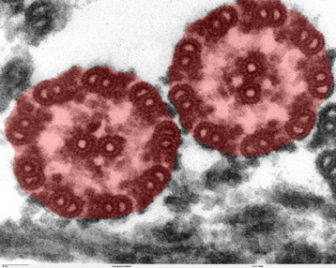
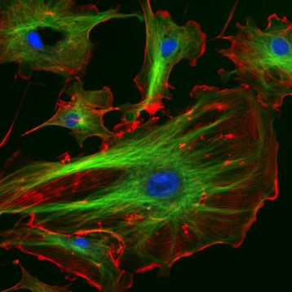
Maintaining Cell Structure
7
Maintaining cell structure
The shape of a cell and coordination of its activities relies on a complex network of filamentous proteins.
These proteins allow cell movement (as in phagocytes) as well as anchoring and movement of organelles.
Microtubles (TEM image)
Image: NIH
7
Microtubles (marked green) and actin filaments (marked red by phalloidin). Nuclei are stained blue by DAPI.

Slide 30
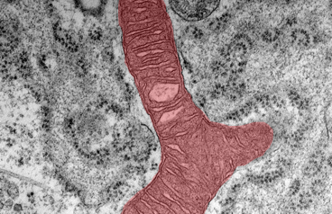
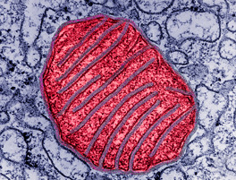
Cellular Respiration
8
Cellular respiration
Cellular respiration is a complex catabolic process, which starts in the cytoplasm (with glycolysis) and is completed in the mitochondria.
It supplies the cell with energy (as ATP)to carry out the many other chemical reactions of metabolism.
TEM of Mitochondria (shaded red)
8
TEM of Mitochondria (shaded red)

Slide 31



Lipid Bilayer
Hydrophilic end
The lipid bilayer acts as the base structure for a cellular membrane.
The lipid bilayer comprises two layers of phospholipid molecules.
Each phospholipid molecule contains a hydrophobic end and a hydrophilic end.
  In an aqueous environment, the phospholipids spontaneously form a bilayer, with the hydrophobic ends pointing together and innermost.
Phospholipid molecule
Hydrophobic end
}
Double layer of phospholipids (lipid bilayer)
Hydrophilic end
Hydrophobic end
Schematic of lipid bilayer

Slide 32


A Fluid Mosaic
The currently accepted model for the structure of the plasma membrane (and cellular membranes generally) is the fluid mosaic model.
  In this model there is a double layer of phospholipids (the lipid bilayer).
  The lipid bilayer is quite fluid, with proteins floating within it.
Some proteins completely penetrate the phospholipid layer.
Proteins embedded in membrane
Phospholipid
Dartmouth College
SEM images of the middle of the membrane show pits and mounds, indicating that proteins span the bilayer.
Some proteins may only reside on the surface or halfway through.

Slide 33

Membrane Structure
Glycoproteins, glycolipids, and cholesterol are also an integral part of the membrane structure, contributing particular properties.
Glycoproteins play an important role in cellular recognition and immune responses. They help stabilize the membrane structure.
Glycolipids act as surface receptors and stabilize
the membrane.
Proteins that completely penetrate the membrane may control the movement of specific molecules into and out of the cell.
Cholesterol in the membrane disturbs the close packing of the phospholipids and regulates membrane fluidity.

Slide 34

Membrane Structure
The plasma membrane is able to control what moves in and out of the cell.
Lipid soluble molecules e.g. gases, can move through the membrane by diffusion
Glycolipids also have a role in helping cells to aggregate in the formation of tissues.
Some substances, particularly ions and carbohydrates, are transported across the membrane via the proteins.
Some carrier proteins move substances across the membrane against their concentration gradient.
Some substances, including water, are transported directly through the phospholipid bilayer.

Slide 35

Role of Membranes
Cell communication and recognition
Isolation of enzymes
Role in protein and membrane synthesis
Energy transfer
Containment of DNA
Role in lipid synthesis
Transport processes
Entry and export of substances
Packaging and secretion

Slide 36

Compartmentalization
Isolation of enzymes
Membrane bound lysosomes contain enzymes for the destruction of wastes and foreign material.
Peroxisomes are the site of the toxic and reactive molecule hydrogen peroxide.
Containment of DNA
The nucleus is surrounded by a nuclear envelope of two membranes, forming a separate compartment for the cell’s genetic material.
1
2
Lysosomes
1
2

Slide 37

Protein and Lipid Synthesis
3
Role in protein and membrane synthesis
Much protein synthesis occurs on free ribosomes on the rough endoplasmic reticulum.
The rough ER is also involved in membrane synthesis, growing by adding proteins and phospholipids.
Role in lipid synthesis
The smooth ER is the site of lipid and steroid synthesis.
4
Mitochondria (TEM)
3
4

Slide 38
Packaging and Transport
5
Transport processes
Channel and carrier proteins are involved in selective transport across the plasma membrane.
Cholesterol in the membrane can help to prevent ions or polar molecules from the passing through the membrane (acting as a plug).
Entry and export of substances
The plasma membrane may take up fluid or solid material and form membrane-bound vesicles within the cell.
Membrane-bound transport vesicles move substances to the inner surface of the cell where they can be exported for the cell by exocytosis.
Packaging and secretion
The Golgi apparatus is a specialized membrane-bound organelle which produces lysosomes and compartmentalizes the modification, packaging and secretion of substances such as proteins and hormones.
6
Golgi body (TEM)
7
6
5
7

Slide 39
Cell Communication and Energy
8
Cell communication and recognition
The proteins embedded in the membrane act as receptor molecules for hormones and neurotransmitters.
Gylcoproteins and glycolipids stabilize the plasma membrane and act as cell identity markers, helping cells to organize themselves into tissues, and enabling foreign cells to be recognized.
Energy transfer
The reactions of cellular respiration take place in the membrane-bound energy transfer systems occurring in the mitochondria and chloroplasts respectively.
Mitochondria (TEM)
9
8
9

Slide 40


Membrane Specialization
The plasma membrane may be specialized to carry out particular functions.
There may also be specialized proteins embedded into the membrane.
Image: WMU
Intercalated discs in cardiac muscle are specialized junctions between adjacent cells that allow rapid spread of nerve impulses.
Desmosomes are anchoring junctions at allow cell to cell adhesion. Desmosomes help to resist shearing forces in tissues subjected to mechanical stress (such as skin cells).

Slide 41


Cell Transport
Substances need to move into and out of the cell. They are moved across the plasma membrane by cellular transport mechanisms. These may be:
  passive (not requiring energy)
    diffusion and facilitated diffusion
    osmosis
  active or energy requiring
    ion pumps
    cytosis
The plasma membrane is partially
permeable to certain molecules.
  Channel and carrier proteins are
  involved in selective transport of small
  molecules and ions across the membrane.
  Large molecules (e.g. proteins) are
  transported by cytosis (formation of
  membrane-bound vesicles or vacuoles).
Plasma membrane
Cell cytoplasm
The plasma membrane is partially permeable, allowing some molecules to pass through, and preventing the passage of others.

Slide 42

Diffusion
Diffusion is a passive transport process. It does not require energy to occur.
Diffusion describes the movement of molecules from regions of high concentration to areas of low concentration down a concentration gradient.
In biological systems, diffusion usually occurs across partially permeable membranes (such as the plasma membrane).
High concentration
Low concentration

Slide 43
Diffusion Across Membranes
Extracellular fluid
In any type of diffusion, each type of diffusing molecule (gas, solvent, solute) moves down its own concentration gradient.
An equilibrium is reached when the net concentration of molecules on either side of the membrane are equal. At this point, net movement stops.
Two-way diffusion across a partially permeable membrane is common in biological systems.
  For example, at the lung surface, carbon dioxide diffuses out of the blood across the membranes of the capillaries and the lung alveoli, while oxygen diffuses in the opposite direction, into the blood.
Partially permeable (plasma) membrane
Cell cytoplasm

Slide 44


Factors Affecting Diffusion
Four main factors affect the rate of diffusion across a membrane:
  Concentration gradient. Diffusion rates will be higher when there is a greater difference in concentration between two regions.
  The diffusion distance. Diffusion over shorter distances occurs at a greater rate than diffusion over larger distances.
  Surface area. The rate of diffusion is greater when there is a large surface area across which diffusion can occur.
  Physical barriers. Thick barriers
  slow the rate of diffusion. Pores in a barrier enhance diffusion.
Human lung
The gas exchange systems of air breathing vertebrates rely on the rapid two-way diffusion of gases across the thin membranes of the lung alveoli.
Air sacs (alveoli)

Slide 45

Fick’s Law
The factors governing the rate of diffusion across membranes are described by Fick’s law.
Fick’s law is expressed as:
Difference in concentration across the membrane
Surface area
of membrane
X
Length of the diffusion path (thickness of the membrane)
Adolf Fick (above) was a German physiologist who proposed the laws that govern gas diffusion across a membrane (Fick’s law). He is also credited with designing the first contact lens and devising the technique for measuring cardiac output (Fick’s principle).

Slide 46

Osmosis
Extracellular fluid
High solute concentration
Osmosis describes the diffusion of water across a partially permeable membrane (the plasma membrane in a cell) when one side of the membrane holds a greater total solute concentration than the other.
A solution with a high solute concentration has a high osmotic pressure.Water will tend to move into it from a solution with a lower solute concentration.
  The higher the solute concentration, the greater the osmotic pressure and the greater the tendency of water to move into the solution across a partially permeable membrane.
Some water can diffuse directly through the lipid bilayer, but movement is also aided by specific protein channels called aquaporins.
Aquaporin
Low solute concentration
Cell cytoplasm

Slide 47

Relative Tonicity
Relative tonicity is used to describe the difference in osmotic pressure between solutions.
Solutions may be:
  Isotonic = same osmotic pressure
  as another solution.
  Hypotonic = lower osmotic pressure relative to another solution.
  Hypertonic = higher osmotic pressure relative to another solution.
Relative tonicity is used to predict the consequences of changes in solute concentration either side of
a partially permeable membrane.
Only solutes that cannot cross the plasma membrane affect tonicity.
michaelberry, Creative Commons 3.0
An understanding of relative tonicity has practical importance. For example, intravenous fluids must present the same osmotic environment as the blood cells they will surround when they are delivered.

Slide 48






Tonicity and Cells
Changes in solute concentrations either side of a membrane can have a marked effect on the structures or cells in a solution.
The effect of changes in the extracellular solute concentration on blood cells is illustrated below:
Tonicity of solution relative to cytosol | Extracellular environment (solution) | Intracellular environment (cytosol) | Consequence to a cell in solution
Hypotonic | Lower solute concentration | Higher solute concentration | Water enters the cell causing it to burst (cell lysis)
Isotonic | Equal osmotic environment |  | Normal shape and form
Hypertonic | Higher solute concentration | Lower solute concentration | Water exits the cell and cell shrinks (crenation)

Slide 49
Facilitated Diffusion
Extracellular fluid
Gases and lipid soluble molecules pass by simple diffusion
Facilitated diffusion refers to diffusion that is aided by integral proteins in the membrane.
Facilitated diffusion selectively increases the diffusion rate of specific molecules.
  It does not require energy because the molecules are not moving against their concentration gradient.
  It occurs when a higher diffusion rate is desirable:
    transport of glucose into skeletal muscle fibers
    transport of ADP into mitochondria
Facilitated diffusion may occur via:
  Channels made by pore-forming proteins (ion channels or ionophores).
  Protein carriers that span the membrane
Partially permeable (plasma) membrane
Integral protein speeds up the rate of diffusion
Cell cytoplasm

Slide 50
Diffusion Through Channels
Extracellular fluid
Inorganic ion
Small polar molecules and ions diffuse rapidly across the membrane by channel-mediated facilitated diffusion.
Protein channels create hydrophilic pores that allow some solutes, usually inorganic ions, to pass through.
Many channels are gated so they can open and close, thus regulating the flow of ions or small polar molecules.
  They are controlled by voltage (voltage-gated channels) or by the binding of a ligand (ligand-gated channels).
  These channels are important in the activity of excitable cells such as nerve and muscle cells.
Channel protein
Cell cytoplasm

Slide 51
Carrier-Mediated Diffusion
Extracellular fluid
Large lipid-insoluble molecules, e.g. glucose
In carrier-mediated facilitated diffusion, larger, lipid-insoluble molecules are aided across the membrane by a transmembrane carrier protein specific to the molecule being transported.
One example is the transport of glucose into red blood cells or skeletal muscle cells.
  Note that glucose transport is not universally passive. In some cells, e.g. intestinal epithelial cells, glucose transport requires energy.
Facilitated diffusion by carriers shows saturation. The diffusion rate approaches a maximum as the carrier proteins become saturated with solute.
Protein carrier (glucose permease) changes shape
Cell cytoplasm

Slide 52


Active Transport Processes
Active transport requires expenditure of energy because materials must be moved against their concentration gradient.
Active transport is performed by specific carrier proteins in the membrane.
Transport proteins harness the energy of ATP to pump molecules from a low concentration to a high concentration (the reverse of diffusion).
  When ATP transfers a phosphate group to the carrier protein, the protein changes its shape so that the bound molecule can move across the membrane.
ATP is the molecule used for energy storage in cells.
30.7 kJ
Energy is released when ATP transfers a phosphate group to a carrier protein. ADP is left to be ‘recharged’.

Slide 53



Sodium-Potassium Pumps
Extracellular fluid
Na⁺
Na⁺
K⁺
The sodium-potassium pump is a protein in the membrane that exchanges sodium ions
(Na⁺) for potassium ions (K⁺) across the membrane.
ATP is used as the energy source for the exchange.
The unequal balance of Na⁺ and K⁺ across the membrane creates large gradients in ion concentration, which can be used to drive other active transport mechanisms.
Na⁺
Plasma membrane
Carrier protein
K⁺
ATP
Na⁺
Na⁺ moves to its binding site
K⁺
Cell cytoplasm

Slide 54

Proton Pumps
Extracellular fluid
H⁺
H⁺
Proton pumps use the energy from ATP to move hydrogen ions (H⁺) from inside the cell to the outside.
This creates a large difference in the proton concentration either side of the membrane, leaving the inside of the plasma membrane negatively charged.
The potential difference created can be coupled to the transport of other molecules across the membrane.
H⁺
H⁺
H⁺
H⁺
Carrier protein
Plasma membrane
ATP
H⁺
Cell cytoplasm

Slide 55

Coupled Transport
Extracellular fluid
Diffusion of sodium ions down their concentration gradient
Coupled transport is also
called co-transport.
  In intestinal epithelial cells, a gradient in sodium ions drives the active transport of glucose.
  The specific transport protein couples the return of the Na⁺ down its concentration gradient to the transport of glucose into the intestinal epithelial cell.
  A low intracellular concentration of Na⁺ is maintained by a sodium -potassium pump.
Na⁺
Na⁺
Na⁺
Glucose
Carrier protein
Na⁺
Plasma membrane
Na⁺
The sodium-glucose symport
Epithelial cell cytoplasm

Slide 56
Summary-Membrane Pumps
Membrane pumps are proteins, which require energy (often as ATP) to transport molecules across the cell membrane.
The activity of pumps may be coupled, e.g. accumulation of Na⁺ from the Na⁺-K⁺ pump drives the transport of glucose against its concentration gradient.
Extracellular fluid
H⁺
Na⁺
Na⁺
H⁺
Na⁺
K⁺
Na⁺
H⁺
Plasma membrane
Na⁺
Na⁺
ATP
ATP
Na⁺
K⁺
H⁺
K⁺
Cell cytoplasm

Slide 57



Chemiosmosis
Within the mitochondria, the movement of H⁺ ions across the membrane is coupled to the synthesis of ATP.
  The energy from electrons (provided by hydrogen carriers, NADH2 and FADH2) is used to move H⁺ ions across the membrane to the inter-membrane space.
  The return of H⁺ to the mitochondrial matrix via ATP synthase is used to produce ATP.
H⁺
H⁺
Outer mitochondrial membrane
H⁺
H⁺
H⁺
H⁺
H⁺
H⁺
H⁺
H⁺
Proton pump
Inter-membrane space
High H⁺ concentration
ATP synthase
H⁺
Mitochondrial matrix
Low H⁺ concentration
Inner mitochondrial membrane
NADH + H⁺
FADH2
2H + ½O2
H⁺
H⁺
H⁺
ADP
H⁺
ATP
NAD⁺
FAD
H2O

Slide 58

Active Transport: Cytosis
Cytosis is a form of active transport involving the formation of membrane-bound vesicles or vacuoles.
Regions of the plasma membrane become infolded (invagination) or outfolded (evaginated) to transport substances across the membrane.
Cells are able to do this because of the mobile nature of the membrane.
Most cells carry out various forms of cytosis, including:
  Endocytosis
  Exocytosis
Endocytosis
Exocytosis

Slide 59


Endocytosis
Phagocytosis
Endocytosis describes the incorporation of substances from outside the cell into the cell as a membrane-bound vesicle or vacuole.
During endocytosis the plasma membrane invaginates (folds in) around the molecules to be transported into the cell.
There are three forms of endocytosis:
  phagocytosis: the engulfment
  of solid particles.
  pinocytosis: the engulfment
  of liquid particles.
  receptor mediated: engulfment of
  specific particles according to
  membrane receptors.
Solid particle
CDC
Pinocytosis
Membrane-bound vesicle

Slide 60

Endocytosis
1
Materials that are to be collected and brought into the cell are engulfed by an invagination of the plasma membrane.
Plasma membrane
2
Vesicle buds off from the plasma membrane.
3
The vesicle carries molecules into the cell. The contents may then be digested by enzymes delivered to the vacuole by lysosomes.
Cell cytoplasm

Slide 61

Endocytosis: Phagocytosis
Phagocytosis (literally cell eating) describes the engulfment and transport of solid particles into the cell.
  The particles are contained within a membrane enclosed sac (a vacuole).
  Digestion of the particles occur when the vacuole fuses with a lysosome containing digestive enzymes.
In humans, white blood cells, such as neutrophils and macrophages, use phagocytosis to clean up cell debris and foreign material such as bacteria.
  The macrophage (right) has engulfed a Staphylococcus bacterium.
Engulfed bacterium

Slide 62
Endocytosis: Pinocytosis
Pinocytosis describes the engulfment of liquids or fine liquid suspensions into the cell.
  Invaginations of the plasma membrane enclose the liquid droplets within small vesicles.
  The fluid within the vesicle is transferred to the cytosol.
Pinocytosis is a non-specific form of endocytosis.
  Whatever solutes are suspended within the watery medium are also taken into the cell.
Plasma membrane engulfing liquid substance.
Membrane-bound vesicle
Pinocytosis by a capillary endothelial cell.
TEM (X12,880)

Slide 63

Receptor-Mediated Endocytosis
Unlike the other forms of endocytosis, receptor mediated endocytosis involves the engulfment and transport of specific molecules into the cell.
The cell membrane has regions of receptor proteins exposed to the extracellular environment.
The receptor proteins occur in clusters (called coated pits) and have binding sites that will only bind specific molecules.
Extracellular fluid
Receptor protein
Plasma membrane
Cytoplasm

Slide 64


Receptor-Mediated Endocytosis
The cytoplasmic side of the coated pit is lined with a special protein called clathrin protein, which provides membrane stability (right).
Target molecule
Clathrin protein
Coated vesicle
When the target molecule (ligand) binds to the receptor protein (left), a coated vesicle forms around it, allowing the molecule to be imported into the cell.

Slide 65
Exocytosis
Exocytosis releases substances from the inside of the cell to outside of the cell.
Exocytosis occurs by fusion of a vesicle membrane with the plasma membrane. The vesicle contents are then released to the outside of the cell.
In multicellular organisms, various types of cells are specialized to manufacture and export products from the cell to elsewhere in the body or outside it.
Transport vesicle
Cross section through the plasma membrane of cardiac muscle showing the presence of transport vesicles. TEM X 162,000

Slide 66

Exocytosis
3
The contents of the vesicle are expelled into the intercellular space (which may be into the bloodstream).
2
Vesicle fuses with the plasma membrane.
1
Vesicle carrying molecules for export moves to the perimeter of the cell.

Slide 67


Cell Division and Organization
Many organisms grow from a single cell, e.g a fertilized egg cell.
As the organism’s cells grow, divide, and multiply, they differentiate and organize themselves into tissues and organs.
During the growth and development of an organism, its cells divide by mitosis.
Reproductive cells are produced by meiosis.

Slide 68







Cell Division: An Overview
Male
adult
A single set of chromosomes
Male
embryo
Sperm
Many mitotic
divisions
2N
Meiosis
A double set of chromosomes
2N
1N
Fertilization
Many mitotic
divisions
Many mitotic
divisions
Child
Somatic cell production
Gamete production
Zygote
2N
Embryo
2N
2N
Somatic cell production
Somatic cell production
Many mitotic
divisions
Female
embryo
Female
adult
Meiosis
Egg
2N
2N
1N

Slide 69



Cell Division
Cell division is the process where a parent cell divides into two daughter cells.
There are two types of cell division:
Mitosis occurs in somatic cells.
Meiosis occurs in the sex organs and produces sex cells (gametes).
Sperm
Ovum (egg)
Mitosis produces genetically identical cells. The chromosomes first condense and line up (top) then separate to opposite ends of the cell (above).
Meiosis (meiotic division) produces sex cells or gametes, sperm and ovum (above).

Slide 70

Mitosis and the Cell Cycle
Mitosis is just one phase of the cell cycle.
There are three main phases in the
cell cycle:
  Interphase (itself comprising three stages)
  Mitosis (nuclear division)
  Cytokinesis (division of the cytoplasm)
Interphase
Anaphase: separation of chromosomes.
Mitosis
Cytokinesis

Slide 71


Interphase
G2
Interphase accounts for 90% of the cell cycle.
  It is the longest phase of the cell cycle.
Interphase consists of three stages:
  First gap phase (G1)
  The cell grows and develops
  Synthesis (S)
  The cell duplicates its genetic material.
  Second gap phase (G2)
    The nucleus is well defined.
    The chromosomes condense into chromatids
    in preparation for division.
    The centrosome (containing the centrioles)
    is replicated.
S
The cell cycle
M
G1
Nucleolus
Centrosome is replicated
Nuclear membrane
Chromatid

Slide 72






Mitosis: Review
Interphase
Early Prophase
Late Prophase
Cell enters mitosis
DNA replicated.
DNA continues condensing.
Chromosomes appear as chromatids.
Metaphase
Centrosome replicated.
Nuclear membrane disintegrates.
Mitotic spindle forms.
Nucleus still well defined.
Nucleolus disintegrates.
Centrosomes move to opposite poles.
Chromosomes line up on the equator of the cell.
Cytokinesis
Telophase
Late Anaphase
Anaphase
Nuclei reform.
Non-kinetochore microtubules elongate the cell.
Chromosomes separate to opposite poles.
Two independent cells.
Cell elongates and furrow develops.

Slide 73



Meiosis In Humans
The purpose of meiosis is to produce haploid sex cells (gametes).
  They have one copy of each homologous pair of autosomes plus one sex chromosome.
  In humans the haploid number is 23.
  A haploid cell results because the chromosomes are replicated once, but the cell undergoes two divisions.
Meiosis only occurs only in the ovaries and testes.
Developing sperm
Spermatogenesis in the testis
Ovaries
Testes

Slide 74














Meiosis
Crossing over may occur at this stage in meiosis
2N
2N
Like mitosis, meiosis is preceded by DNA replication.
Meiosis comprises two divisions:
  Meiosis I: This first division separates the homologous chromosomes into two intermediate cells.
  Meiosis II: Effectively a mitotic division, but the number of chromosomes remains the same because they are not duplicated a second time.
The chromosomal number is halved (1N) during meiosis I, and remains so throughout meiosis II.
First Division
(reduction division)
2N
1N
Intermediate cell
Intermediate cell
Second Division
('mitotic' division)
1N
1N
Gametes
(eggs or sperm)

Slide 75




Fertilization
The union of one sperm and one egg cell (fertilization) produces a zygote.
  A zygote is totipotent; it has the capacity to differentiate into a fully formed embryo.
Egg cell
Sperm cell
Fertilization
Zygote (first division)
Morula (4-5 divisions)

Slide 76









Differentiation of Human Cells
Regulation of gene expression determines what cell type will develop from a totipotent embryonic cell (a stem cell).
Gene expression is regulated so that some genes are switched on (activated), and others are switched off (deactivated) during the course of development.
Blood vessels
Spinal tissue
Glands
Kidney
Bone
Mesoderm
Ectoderm
Endoderm
Germline
Lung
Gastrula:
two layered embryo
Sperm producing cells
Zygote:
fertilized egg

Slide 77




Differentiation Potential
A zygote has unlimited ability to differentiate; it can develop into any cell type.
As the organism develops, the differentiation potential of a cell lessens,so that fewer differentiation options are available.
Eventually, a cell’s fate is determined, and it takes on a specific form and function.
Germ line
Endoderm
Mesoderm
Ectoderm
Zygote:
fertilized egg
Morula:
solid ball of cells
Gastrula:
two layered embryo
Brain and spinal cord
Somites (muscle)
In this a 24 hour chick embryo the differentiation of the brain, spinal cord, and muscle has already begun.
Spinal tissue

Slide 78





Differentiation of Human Cells
Cell specialization begins four days after fertilization at the blastocyst stage.
Gastrulation is the next phase of embryonic development. Its purpose is to position the three distinct germ layers: the endoderm, mesoderm, and ectoderm.
Gastrulation is achieved by migration of the embryonic cells within the embryo. The three germ layers (or cell lines) are the forerunners for all adult cells and tissues.
Because three germ layers form, all vertebrate embryos are said to be triploblastic.
Zygote
Fertilized egg cell
Blastula
Hollow ball of cells
Eight cell stage
Gastrulation
Gastrula
Cleavage
Cleavage
Endoderm
Ectoderm

Slide 79


Endoderm
The endoderm is the innermost germ layer.
In the early embryo, the endoderm forms the embryonic gut.
It differentiates to form:
  The liver, pancreas, and most of the digestive tract
  The thyroid and parathyroid glands
  Lungs and epithelial lining of trachea
  Bladder and lining of urethra
Lung
Thyroid
Pancreas

Slide 80



Mesoderm
The mesoderm is the middle germ layer, between the ectoderm and endoderm.
The mesoderm differentiates to give rise to:
  Muscles
  Circulatory system (heart and blood vessels)
  Urogenital system
  Dermis (inner skin layer)
  Skeleton, and other supportive and
  connective tissue
Bone
Skeletal muscle
Kidney tissue
Red blood cells and blood vessels
Smooth muscle (gut)

Slide 81


Ectoderm
The ectoderm is the outermost germ layer.
In the fully developed embryo and adult human the ectoderm forms:
  Nervous system
  Epidermis of skin (including hair, sweat glands, and nails)
  Tooth enamel
  Cornea and lens of the eye
Neurons
Epidermis (skin)
Sebaceous glands
Retinal and pigment cells

Slide 82









Differentiation of Human Cells
The human body exhibits a high level of cellular specialization.
  All of the 230 cell types in a human body are derived from a single zygote by differentiation.
  Because the zygote is totipotent, it has the capacity to differentiate into a fully formed embryo.
White blood cell
Intestinal epithelial cell
Bone cell
➙
➙
➙
➙
➙
Muscle fiber
Retinal cone
➙
➙
➙
Red blood cell
Nerve cell
Retinal rod

Slide 83
Human Cell Specialization
Red blood cell (erythrocyte)
    Features:
    Biconcave cell. Lacks nucleus and mitochondria. Contains the oxygen-binding protein pigment hemoglobin.
    Functions:
    Uptake, transport, and release of oxygen to the tissues.
No nucleus
Hemoglobin gives red color
Phagocytic white blood cell (neutrophil)
    Features:
    Highly mobile cell capable of engulfing bacteria and other foreign material by phagocytosis.
    Functions:
    Engulfs and destroys pathogens, foreign material and cell debris.
Phagocytic
Highly mobile

Slide 84


Hematopoiesis
Hematopoiesis describes the production of blood cells.
New blood cells are produced in the red bone marrow.
All types of blood cell develop from a multipotent stem cell
or hemocytoblast.
These are capable of mitosis and differentiation into committed precursors of each of the main blood cells.
White blood cell
Image:NCI Frederick
Red blood cell
Platelet

Slide 85

















Hematopoiesis
Hematopoiesis from haem (=blood) and poiesis (to make)
Matures in thymus
T lymphocyte
Natural killer (NK) lymphocyte
Lymphoid precursor cell
B lymphocyte
Monocytes and macrophages
Multipotent stem cell
Neutrophil
Basophil
Granulocytes
Eosinophil
Red bone marrow
Myeloid precursor cell
Red blood cells
Megakaryocyte
Platelets

Slide 86
Human Cell Specialization
Motor neuron
    Features:
    Cell has long extensions (axons) with
    synaptic bodies. May be insulated with fatty
    material (myelin) for improved conduction speed.
    Functions:
    Rapid conduction of nerve impulses from spinal cord to effectors.
Retinal rod
    Features:
    Long, narrow cell specialized to receive and respond to light energy. Contains light sensitive pigment (rhodopsin).
    Functions:
    Vision. Detection of light results in a structural change and generation of a nerve impulse.
Insulated axon
Synaptic bodies
Nucleus
Membrane disks containing pigment

Slide 87



Human Cell Specialization
Microvilli
Intestinal epithelial cell
    Features:
    Columnar cell with a high surface area to volume ratio as a result of finger-like projections on the surface (microvilli).
    Functions:
    Rapid absorption of nutrients into the blood.
Skeletal muscle cells (fibers)
    Features:
    Large, multinucleate cylindrical cells composed
    of banded myofibrils. Capable of contraction.
    Functions:
    Responsible for movement via the action of voluntary muscles on the skeleton.
Epithelial cells line the villi of the intestine
Nucleus
Plasma membrane of muscle cell
Muscle fibers in cross section
Nucleus
Myofibrils

Slide 88

Human Cell Specialization
Spermatocyte
    Features:
    Motile, flagellated cell with many mitochondria. The nucleus forms a large proportion of the cell.
    Functions:
    Male gamete for sexual reproduction.
Osteoblast
    Features:
    Cell surrounded by a calcium matrix. Fingerlike extensions supply nutrients and remove wastes from the cell.
    Functions:
    In early stages, secretes the matrix that will become bone. Provides strength.
Nucleus
Maturing spermatozoa
Fingerlike extensions of cytoplasm
Bone tissue: the osteoblasts stain dark blue

Slide 89




Types of Tissues
Biological tissue is a group of cells that perform a similar or related function.
Tissues improve the efficiency of operation because they enable tasks to be shared amongst various specialized cells.
The study of tissues is called histology.
Animal tissues can be divided into four broad groups:
  epithelial tissue, e.g columnar epithelium of
  gall bladder
  connective tissue, e.g. bone
  muscle tissue, e.g. cardiac muscle
  nervous tissue, e.g. neurons, glial cells
A
B
A
B
C
C
D
D

Slide 90

Connective Tissue
Connective tissue is the major supporting tissue of the animal body.
The cells are widely dispersed in a matrix, which ranges from being dense, (e.g. bone) to fluid (e.g. blood).
Connective tissues bind other structures together and provide support, and protection against damage, infection, or heat loss.
Connective tissues include:
  Dentine (teeth)
  Adipose (fat) tissue
  Bone and cartilage
  Tissues around the body’s
  organs and blood vessels
  Blood (a liquid tissue)
In this embryo of a mouse, bone (magenta) and cartilage (blue) are highlighted by selective staining

Slide 91


Nervous Tissue
Nervous tissue consists of two principal cell types:
  Neurons: the structural and functional cells of the nervous system. Neurons are specialized to transmit and receive nerve impulses.
  Neuroglia: the supporting cells of the nervous system. They are highly branched, supportive cells, which do not conduct nerve impulses.
Neurons
Image:Orchinik Lab, Arizona State University
Neuroglia

Slide 92



Nervous Tissue
Supporting cells and connective tissue containing blood vessels may be associated with the neurons.
Photos right:
  Axon branches supplying muscle fibers.
  Layer of giant Purkinje neurons of the cerebellum.
  Motor neurons (arrowed) from the spinal cord. Supporting glial cells lie in between.
A
A
B
C
B
C

Slide 93

Muscle Tissue
Muscle tissue consists of highly specialized cells called fibers, held together by connective tissue.
  The main feature of muscle tissue is that it is contractile and therefore responsible for both voluntary and involuntary (unconscious) body movements.
  Contraction is accomplished by the interaction of contractile proteins.
I band (light)
One sarcomere.
A band (dark)
Z line
I band (light)
H zone
Muscle tissue

Slide 94



Muscle Tissue
There are three types of muscle in the body:
  Cardiac muscle: cylindrical, branching cells connected by gap junctions.
  Skeletal muscle: large, long, cells with multiple peripheral nuclei.
  Smooth muscle: no striations, spindle-shaped cells with single central nucleus.
Type: Cardiac muscle
Location: Heart
Type: Skeletal (striated) muscle
Location: Attached to bone.
Type: smooth muscle. Location: walls of hollow organs, skin, glands

Slide 95


Epithelial Tissue
Epithelial tissue is organized into single or layered sheets of cells.
Epithelial tissue lines internal and external surfaces (e.g. blood vessels, ducts, gut lining) and protects the underlying structures from wear, infection, or pressure.
Epithelial cells rest on a basement membrane and are held together by a glue-like intercellular substance.
Epithelial cells may also be ciliated or variously specialized for absorption, secretion, or filtration.
Simple columnar epithelium, gall bladder
Image: EII
Ciliated epithelium

Slide 96

Describing Epithelia
Epithelia are classified as simple (single layered) or stratified (two or more layers).
The cells may be squamous (flat), cuboidal (roughly cube-shaped), or columnar (column-shaped).
Therefore, at least two adjectives describe any particular epithelial
cell, e.g:
  Simple cuboidal
  Stratified squamous
Image: Ebustad
Simple cuboidal epithelium

Slide 97


Specialized Epithelia
Pseudostratified epithelium is a type of simple epithelium that appears layered because the cells are of different heights.
Transitional epithelium is a type of stratified epithelium which is capable of considerable stretching.
  Transitional epithelium lines organs such as the urinary bladder.
Epithelia may be modified, e.g. ciliated or specialized for secretion, absorption, or filtration.
  Glandular epithelium is specialized
  for secretion.
  Epithelia in the reparatory tract
  are ciliated.
Image: EII
Pseudostratified columnar epithelium
Image:Polarlys CC 3.0
Transitional epithelium, urinary bladder

Slide 98


Simple Epithelia
The simple epithelium of the gastrointestinal tract (left) is easily recognized by the regular column-like cells.
It is specialized for secretion
and absorption.
Image:WbenSmith
Simple columnar epithelium
Simple cuboidal epithelium is common in glands and their ducts.
It also lines the kidney tubules (right) and the surface of the ovaries.
Image: Ebustad
Simple cuboidal epithelium

Slide 99


Squamous Epithelia
Simple squamous epithelium lines surfaces where rapid diffusion is required, such as in the capillaries, alveoli (bottom left), and lining the glomerular capsule (top left).
Image: EII
Simple squamous epithelium in kidney
Image: EII
Simple squamous epithelium in alveoli

Slide 100



Stratified Epithelia
Stratified epithelium is more durable than simple epithelium because it has several layers.
It has a protective role and can
be keratinized, e.g. in skin (right), or without keratin, e.g. in the vagina (below).
Image: EII
Image: EII
Non-keratinized stratified epithelium.
Keratinized stratified epithelium.

Slide 101





Levels of Organization
Organization is a defining feature of living things.
Organisms are organized according to a hierarchy of structural levels.
Organ system level
Chemical and molecular level
Organelle level
Organ level
Cellular level

Slide 102



Levels of Organization
  Chemical and molecular level:
  Atoms and molecules form the most basic level of organization. This level includes all the chemicals essential for maintaining life.
Stearic acid
Phospholipid
Thymine

Slide 103



Levels of Organization
  Organelle level:
  Molecules associate together to form complex, highly specialized structures and organelles within cells. e.g. mitochondria, Golgi apparatus.
Golgi apparatus
Cellular level:
Cells are the basic structural and functional units of organisms. Cells become specialized to perform specific functions as a result of differentiation during development.
Mitochondria
Liver cells
Kidney tubule cells

Slide 104




Levels of Organization
  Tissue level:
  Tissues are composed of groups of cells of similar structure that perform particular related functions. Examples include: epithelial tissue, liver tissue, bone, and kidney tissue.
Liver tissue and bile duct
Kidney tissue: glomeruli, tubule cells, Bowman’s capsule
Organ level:
Organs are structures of definite form and structure, comprising two or more tissues. Examples include: kidneys, liver, heart, brain, lungs, stomach.
Photo:Suseno
Liver
Kidney

Slide 105

Levels of Organization
  Organ system level:
  In humans and other animals, organs form parts of larger units known as organ systems.
  An organ system is an association of organs with a common function, e.g. digestion or excretion.
11 organ systems make up the body.
Kidneys are organs of excretion and are part of the excretory system.

Slide 106











Human Organ Systems
Circulatory
Digestive
Endocrine
Excretory
Lymphatic
Female
Female
Musculature
Male
Male
Nervous
Reproductive
Respiratory
Skeletal
Skin

Slide 107
Human Organ Systems
Circulatory
Digestive
Endocrine
Excretory
Lymphatic
Musculature
Nervous
Reproductive
Respiratory
Skeletal
Skin

Slide 108
Human Organ Systems
Circulatory
Digestive
Endocrine
Excretory
Lymphatic
Musculature
Nervous
Reproductive
Respiratory
Skeletal
Skin

Slide 109
Glossary
Click a word from the glossary to go to that slide!
ATP | A nucleotide comprising a purine base, a pentose sugar, and three phosphate groups, which acts as the cell’s energy carrier.
Catabolic | Metabolic pathways that break down molecules into smaller units and release energy.
Chromatid | One of two identical DNA strands forming the chromosome and held together by the centromere after DNA replication.
Chromosome | Single piece of DNA that contains many genes and associated regulatory elements and proteins. Found within the nucleus in eukaryotes and as a singular circular structure in prokaryotes.
DNA | Deoxyribonucleic acid. Double stranded nucleic acid construction of one of four bases (A, T, C, G), a phosphate group and deoxyribose sugar. Stores the genetic code in all organisms.
Equilibrium | System in which competing influences are balanced. Across a membrane, the movement of substance A from side 1 to side 2 of the membrane is balanced by its movement from side 2 to side 1 of the membrane.
Gene expression | The entire process of transferring information encoded in a gene into a gene product.
Glycolipid | Lipid with a carbohydrate attached.
Glycoprotein | Protein with carbohydrate attached.
Hemoglobin | A large iron-containing protein, which transports oxygen in the blood of vertebrates.
Hydrophobic | (Hydro- = water, -phobic = fear). Literally meaning ‘fearing water’. Substance which repels or does not mix with or dissolve in water e.g. oils or non polar substances.
Hydrophilic | (Hydro- = water, -philic = love or affection). Literally meaning ‘loving water’. Substance which is attracted to or can be dissolved by water e.g. salts or polar substances.
Metabolism | Biochemical reactions that occur within a organism. They in both catabolic and anabolic reactions.

Slide 110
Glossary
Click a word from the glossary to go to that slide!
Myofibrils | Threadlike structures running longitudinally through a muscle fiber. They consist of either thick filaments (myosin) or thin filaments (actin, troponin, and tropomyosin).
Ovaries | The part of the reproductive system of females in which eggs develop. Also responsible for the production of the hormones estrogen and progesterone.
Phospholipid | A class of amphipathic lipids, they are a major component of all plasma membranes as they can form lipid bilayers.
Protein | Complex macromolecule built up from amino acids and joined together by peptide bonds. All proteins contain carbon, hydrogen, oxygen and nitrogen and most contain sulfur.
RNA | Ribonucleic acid. Single stranded nucleic acid constructed of a base (A, U, C, G) a phosphate group and a ribose sugar. Three types are identified tRNA, mRNA and rRNA.
Solute | The substance that is dissolved into the solvent. For example, in a mixture of sodium chloride and water, the water is the solvent while the sodium chloride is the solute.
Solution | The mix of a solute and and solvent, e.g. sodium chloride and water.
Solvent | The substance into which the solute dissolves. For example, in a mixture of sodium chloride and water, the water is the solvent while the sodium chloride is the solute.
Testes | The part of the reproductive systems of males in which sperm develop. Also responsible for the production of the hormone testosterone.

Slide 111


Slide 112
Conditions of Use
NOTE: Presentation Media = presentations available on CD-ROM/DVD-ROM or as downloads
BIOZONE retains copyright to the intellectual property included in the Presentation Media files, with acknowledgement that certain photos are used under license and are credited appropriately.
You MAY:
Use the Presentation Media files for presentations in your classrooms using a
data projector, interactive whiteboard or overhead projector.
Place the Presentation Media files on any staff computer within the school,
including staff laptops, but not in contradiction to clause (g).
Place the Presentation Media files on:
  The school’s intranet (school computer network)
  VLE (Virtual Learning Environment)
  A CMS (Content Management System).
Student and staff access must be restricted to those who are enrolled/working on the campus of the registered purchaser. Student and staff access to a VLE or a CMS must be controlled by a user login and password protocol, but not in contradiction to clause (f). If students have access, they need to be made aware of the Conditions of Use and are only allowed to view the content.
Edit and customize the Presentation Media files by adding, deleting, and
modifying information to better suit your needs, but not in contradiction to
clauses (h) - (l).
Print out the Presentation Media files in PowerPoint® or Keynote®
“Handouts” mode for the express purpose of allowing students to make their
own notes about the presentation, but not in contradiction to clause (j).
You MAY NOT:
Place the Presentation Media files on to the Internet or on a service that may be
accessed off-campus unless access to the service is protected by a user login
and password protocol, and is restricted to students and staff enrolled/working on
the campus of the registered purchaser.
Place the Presentation Media files on student laptop computers.
REMOVE any of the references to BIOZONE, the title slides, copyright
notices, photo credits, or Conditions of Use from the Presentation Media
files.
Create a NEW document using any of the graphics/images in the Presentation
Media files.
Print the Presentation Media files on to paper to make your own worksheets for
distribution to students.
Incorporate any part of the Presentation Media files for the production of another
commercial product.
Share or give away any content off-campus. This prohibition apples to, but is not
limited to, sharing via the Internet or any website, (examples: YouTube, slide
sharing websites).
Conditions of Use are subject to change without notice. Visit www.thebiozone.com/conditionsofuse

Slide 113
Photo Credits
Photographic images are used under license from the following commercial photo libraries:
  Corel Corporation Professional Photos (uncoded)
  ArtToday.com (coded AT)
  Clipart.com (coded CA)
  PhotoObjects.com (coded PO)
  iStock.com (coded iStock)
  Hemera Technologies Inc. (coded Hemera)
  Photos.com (coded PC)
  Education interactive (coded EII)
  Visuals unlimited (coded UV)
  Waikato Microscope Unit (Coded WMU)
  Digital Stock (coded DS)
  LifeArt (coded LA)
3D models were created using Poser 8
Additional artwork and photographs are the property of BIOZONE International Ltd. All rights reserved.
Some 2D artwork has been adapted from TechPool STUDIOS LifeArt Collections, used under licence.
Images from the Public Domain: Where these licenses have been used, authors and licenses have been acknowledged alongside their image.
  Centers for Disease Control (coded CDC)
  National Institutes of Health (coded NIH)
  Images from the public domain include limited copyright,
  copyright expired, uncopyrighted, or uncopyrightable material:
    Licenses including: GNU Free Documentation License
    http://www.gnu.org/copyleft/fdl.html
    Creative Commons Attribution Share Alike
    http://creativecommons.org/licenses/by-sa/3.0/
    Wikimedia Commons
NOTE: Where images are edited or moved from or within this file, the accompanying photo credit must be retained.

Slide 114


